Slide 1
ULTRASONIC SENSOR-1
LED/BUZZER
BLUETOOTH
IR RECIEVER
LCD DISPLAY
ARDUINO MEGA
2560
POWER SUPPLY
BOARD
GPRS
GSM
MOTOR DRIVE BOARD
IR SENSOR
ULTRASONC SENSOR-2
MOTOR
1
MOTOR
2

Slide 2
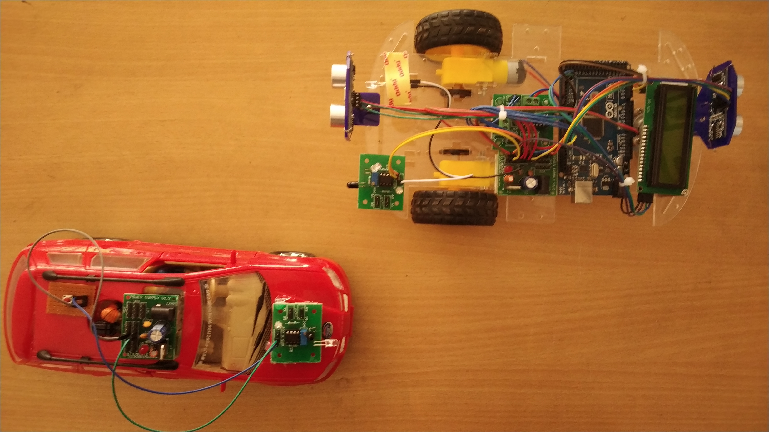
ULTRASONIC SENSOR 1
MOTOR DRIVE BOARD
ULTRASONIC SENSOR 2
IR RECIEVER
↓
SWITCH & POWER BOARD
→
LCD DISPLAY
POWER SUPPLY BOARD
ARDUINO
IR TRANSMITTER

